Slide 1
Operation Analytics and Investigating Metric Spike
Analysis of Job Data and User Engagement Metrics

Slide 2
Project Description
The aim of this project is to perform Operational Analytics on the company's data to identify the areas for improvement and understand sudden changes in key metrics. This involves working closely with various teams such as operations, support, and marketing to get valuable insights from the data collected. The project was divided into two case studies: Job Data Analysis and Investigating Metric Spike.

Slide 3
Approach
My approach involved the following steps:
Data Collection: Accessing and understanding the dataset provided.
Query Design: Writing SQL queries to extract relevant information.
Analysis: Interpreting the data to identify trends, patterns, and anomalies.
Reporting: Summarizing the findings and presenting them in a either a PDF or PPT.

Slide 4
Tech-Stack Used
MySQL Workbench (Version 3.0): For writing and executing SQL queries.
Microsoft Excel: To export data in CSV to MySQL and for showing full outputs for the necessary queries .
Microsoft PowerPoint: For creating the presentation.

Slide 5
Case Study 1
Job Data Analysis

Slide 6
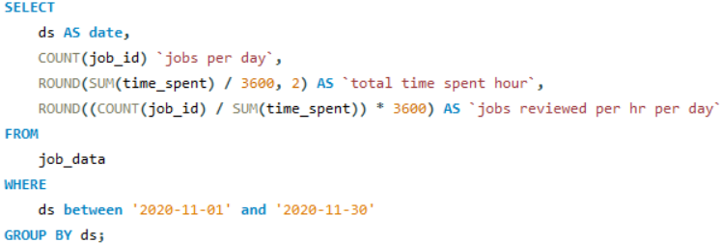
A) Jobs Reviewed Over Time
Objective: Calculate the number of jobs reviewed per hour for each day in November 2020.
My Task: Write an SQL query to calculate the number of jobs reviewed per hour for each day in November 2020.
Query:

Slide 7
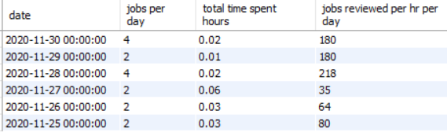
Output: The number of jobs reviewed for each hour of each day in November 2020.
This query provides the number of jobs reviewed for each hour of each day in November 2020. Analyzing this data can help us understand peak times for job reviews, allowing the company to allocate resources more efficiently.

Slide 8
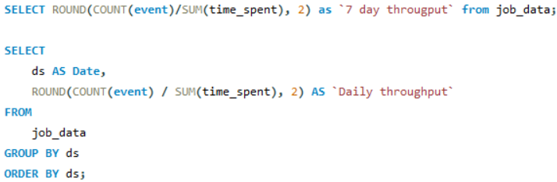
B) Throughput Analysis
Objective: Calculate the 7-day rolling average of throughput (number of events per second).
My Task: Write an SQL query to calculate the 7-day rolling average of throughput.
Query:

Slide 9

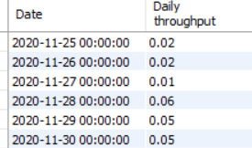
Output:
7 day throughput Daily throughput
The 7-day rolling average smooths out daily fluctuations in data. It provides a clearer trend over time by averaging the values of the past 7 days. It is useful for understanding underlying trends without the daily variations, making it preferable for long-term strategic decisions.

Slide 10
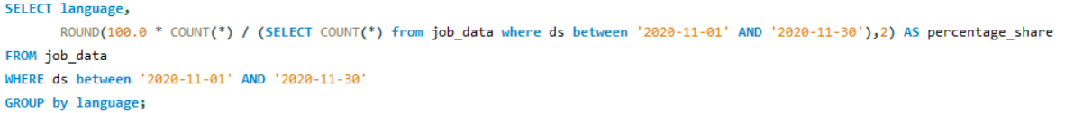
C) Language Share Analysis
Objective: Calculate the percentage share of each language in the last 30 days.
My Task: Write an SQL query to calculate the percentage share of each language over the last 30 days
Query:

Slide 11
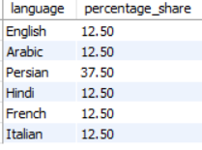
Output: Percentage share of each language over the last 30 days
This query calculates the relative share of each language over the last 30 days, providing insight into which languages are most frequently used. This can inform language-specific strategies, such as localization efforts or targeted marketing.

Slide 12
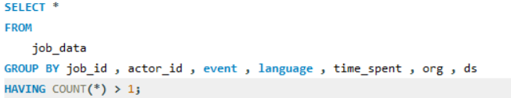
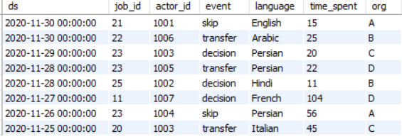
D) Duplicate Rows Detection
Objective: Identify duplicate rows in the data.
My Task: Write an SQL query to display duplicate rows from the job_data table.
Query:
Output: Duplicate rows in the job_data table.
This query identifies rows that appear more than once in the dataset. Detecting and addressing duplicates is crucial for maintaining data quality and ensuring accurate analysis.

Slide 13
Insights: Case Study 1 - Job Data Analysis
Jobs Reviewed Over Time: Identified peak hours for job reviews, helping allocate resources more effectively.
Throughput Analysis: The 7-day rolling average provided a stable view of throughput, highlighting long-term trends.
Language Share Analysis: Determined the most common languages used, for deploying language-specific strategies.
Duplicate Rows Detection: Ensuring data quality by identifying duplicates.

Slide 14
Case Study 2
Investigating Metric Spike

Slide 15

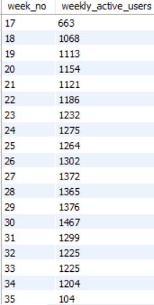
A) Weekly User Engagement
Objective: Measure the activeness of users on a weekly basis.
My Task: Write an SQL query to calculate the weekly user engagement.
Query:
Output:
The query calculates the number of events each user has taken on a weekly basis. By analyzing the results, we can determine which weeks had higher user engagement and identify patterns and trends in user activity.

Slide 16
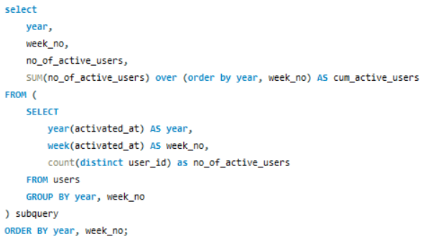
B) User Growth Analysis
Objective: Analyze the growth of users over time for a product.
Your Task: Write an SQL query to calculate the user growth for the product.
Query:
Output:

Slide 17
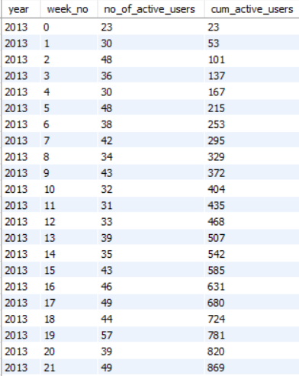
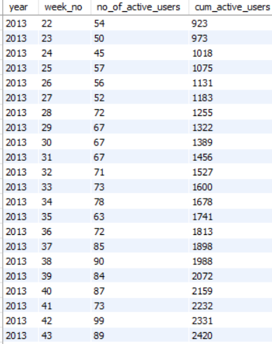
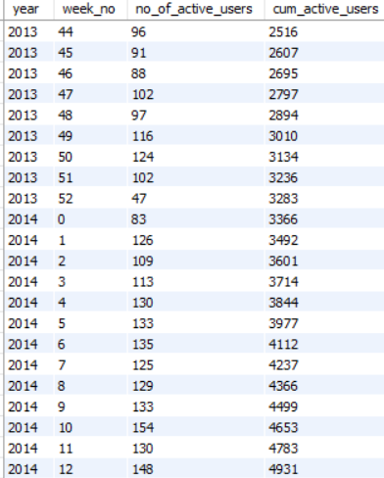
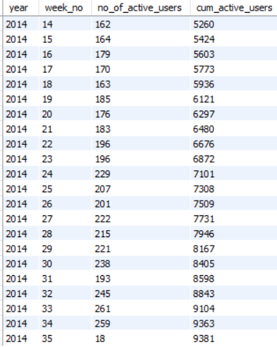
The query calculates the number of new users who have signed up each month. By examining the trend of new user signup, we can assess the growth rate of the product. An increasing trend indicates good user acquisition, while a decreasing trend might signal the need for improved marketing or product features.

Slide 18
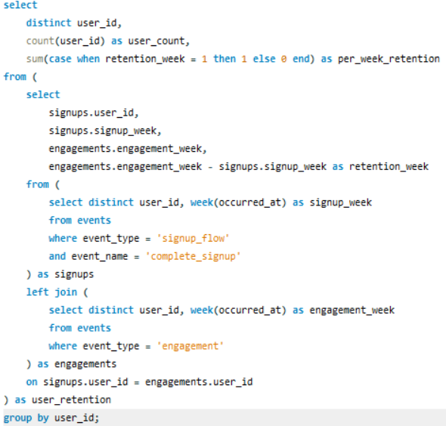
C) Weekly Retention Analysis
Objective: Analyze the retention of users on a weekly basis after signing up for a product.
My Task: Write an SQL query to calculate the weekly retention of users based on their sign-up cohort.
Query:

Slide 19
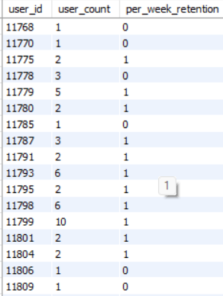
Output:
(Full output in MS Excel file in the drive)
This query calculates the number of users retained each week after their signup week. By analyzing the retention data, we can understand how the product retains users over time. High retention suggest users find ongoing value in the product, whereas low retention might indicate issues with user engagement or satisfaction.

Slide 20
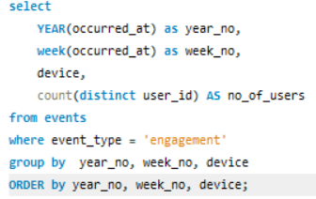
D) Weekly Engagement Per Device
Objective: Measure the activeness of users on a weekly basis per device.
My Task: Write an SQL query to calculate the weekly engagement per device.
Query:

Slide 21
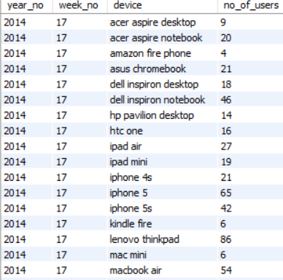
Output:
(Full output in excel file in the drive)
This query calculates the number of events each user performs on different device types on a weekly basis. By analyzing the results, we can identify which devices are most frequently used and understand the user preferences. This information can guide marketing strategies.

Slide 22
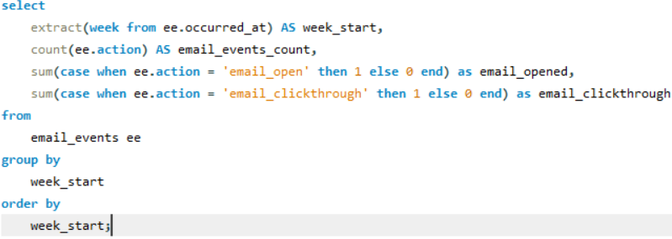
E) Email Engagement Analysis
Objective: Analyze how users are engaging with the email service.
Your Task: Write an SQL query to calculate the email engagement metrics.
Query:

Slide 23
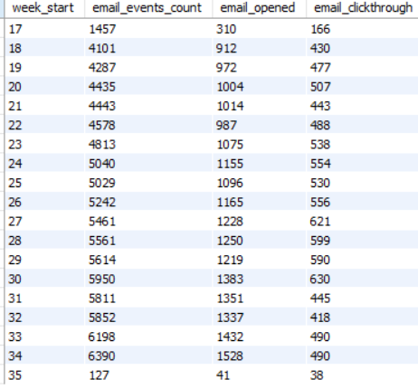
Output:
This query calculates the number of email events on a weekly basis. By analyzing the results, we can check the effectiveness of the email campaigns. High email_opened and email_clickthrough rates indicate successful email content and targeting, while low rates might suggest the need for improved email design or segmenting the audience.

Slide 24
Insights: Case Study 2 - Investigating Metric Spike
Weekly User Engagement: Tracked weekly user activity, identifying trends and high engagement periods.
User Growth Analysis: Analyzed user growth over time, evaluating marketing effectiveness.
Weekly Retention Analysis: Identified retention patterns, focusing on periods with high drop rates.
Weekly Engagement Per Device: Measured device-specific engagement, guiding optimization efforts.
Email Engagement Analysis: Evaluated the effectiveness of email campaigns and user interaction.

Slide 25
Result
Through this project, achieved a deeper understanding of operational metrics and user behavior. The analysis provided actionable insights that can help company improve the resource allocation, enhance user engagement, and refine marketing strategies. This will assist the decision making teams in making informed decisions to drive the company's growth and efficiency.

